Slide 1
Greek Temples

Slide 2
Greek Temples
Temple of Hera, Paestum
Temple of Poseidon, Sounion
Temple of Apollo, Bassae
Notes:
Temples are found everywhere in the Greek World. Paestum is a Greek colony on the Bay of Naples in Italy, Sounion is on the coast of Attica to the south east of Athens, while Bassae is in the central Peloponnese.

Slide 3
Parthenon
Notes:
The most famous Greek temple is the Parthenon (completed in 438 BC). This temple, dedicated to Athena, is on the Acropolis of Athens.

Slide 4
What were they for?
Athena
Zeus
Apollo
Notes:
Temples were constructed to house the cult statue of the god or goddess it was dedicated to. Most temples were seen as houses to the gods and the statue symbolised the presence of the deity within the temple. These examples are:
1. Reconstruction of the statue of Athena from the Parthenon.
2. Statue of Apollo inside a temple from a Greek painted pot.
3. Reconstruction of the statue of Zeus from the temple of Zeus at Olympia.

Slide 5
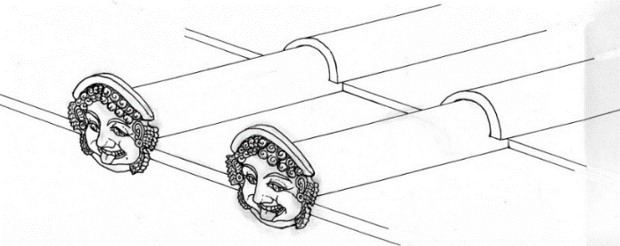
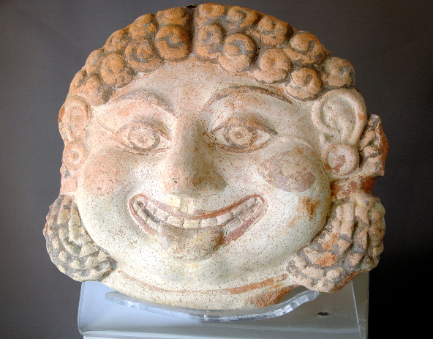
Temple Elements
Antefixes
Notes:
Many Greek temples shared similar architectural elements, including a pediment, columns and a frieze.

Slide 6
Temple Plan
Notes:
Greek temples were built on a platform (stylobate). The interior of the temple was often divided into three sections: the cella or naos where the statue of the god would be located, the pronaos (front porch) and opisthodomos (rear porch). The interior was surrounded by a colonnade (peristyle) on all four sides.

Slide 7
The Greek ‘orders’
Doric
Ionic
Corinthian
Notes:
The Greeks built in distinctive architectural styles, which were later on referred to as ‘orders’. Each one treated the architectural elements (columns, frieze etc.) differently.

Slide 8
Doric
Triglyph
Metope
Guttae
Notes:
The Doric frieze consists of distinctive elements referred to as triglyphs, metopes and guttae. This example is from the Hephaisteion, a temple to the god Hephaistos in Athens.

Slide 9
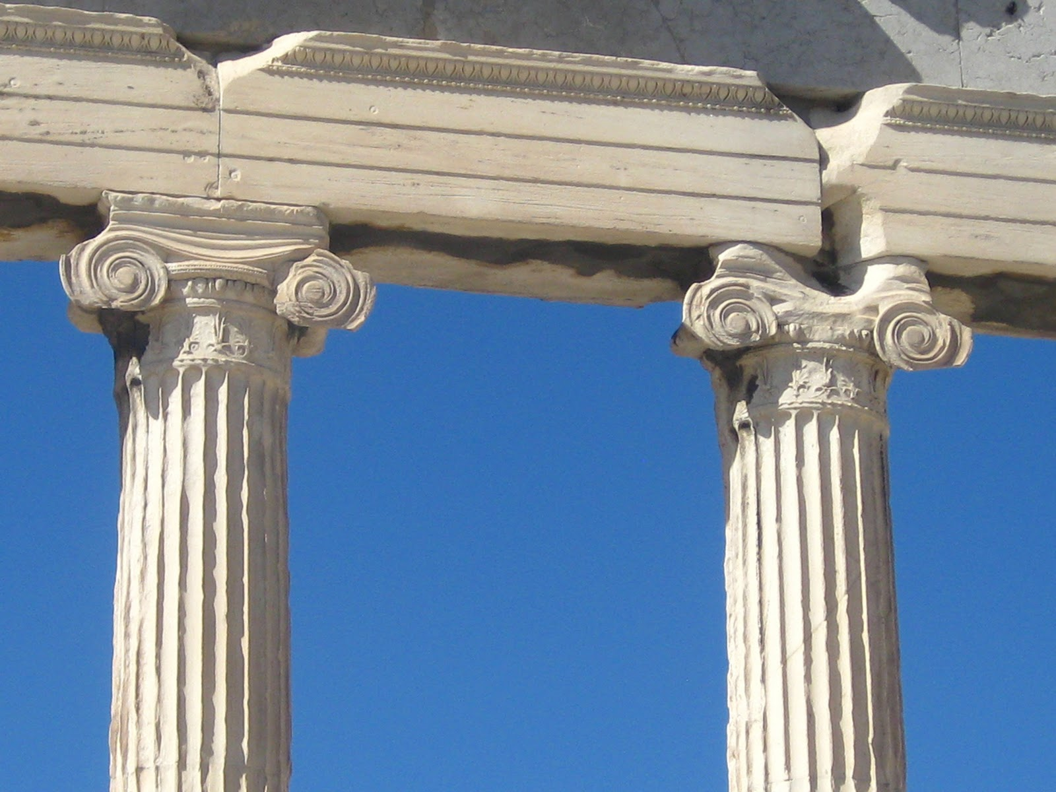
Ionic
Notes:
Examples of the Ionic ‘order’. The distinctive curled elements on the Ionic column capital are called volutes.

Slide 10
Corinthian
Notes:
Examples of the Corinthian ‘order’. The column capitals are decorated with acanthus leaves.

